Slide 1
PASSWORD STRENGTH ANALYZER
Kariem Abdelmoniem Ahmed
Abdelrahman Mohammed
Kirollos Raouf

Slide 2
Project Overview
Purpose:
Explain why password security is essential (e.g., increasing cyber attacks, weak passwords causing breaches).
Objective: Build a tool to:
Assess password strength (length, complexity, entropy)
Identify common passwords
Provide recommendations for improvement (not obviously!)

Slide 3
Key Features
Entropy Calculation: Measures randomness/strength of a password.
Password Complexity:
Checks for:
Lowercase letters
Uppercase letters
Digits
Special characters
Common Password Detection: Matches against a database of most-used passwords.
Scoring System: Assigns a strength level (Weak, Medium, Strong).

Slide 4
Workflow
Input: User enters a password.
Check Database: Verify if it’s a common password.
Entropy Calculation: Assess strength using character sets.
Complexity Check: Analyze characters used.
Scoring & Feedback: Determine password strength and provide recommendations.
Output: Display the results.

Slide 5
Code Snippets

Slide 6
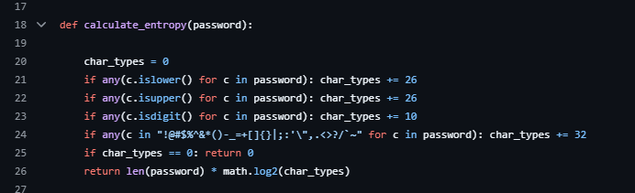
Entropy Calculation
Measures password randomness based on character sets.

Slide 7
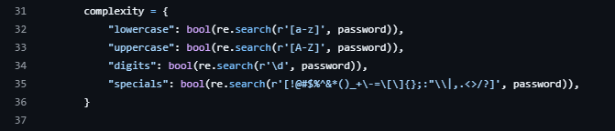
Complexity Check

Slide 8
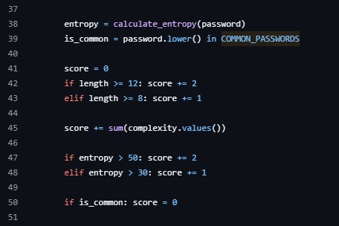
Scoring System

Slide 9
Scoring System
Criteria:
Length: >=12 (Strong), >=8 (Medium)
Complexity: Number of character sets (lowercase, uppercase, digits, special)
Entropy:
50 → Strong
30-50 → Medium
Common Passwords: If found → Immediate Weak score.
Strength Levels:
Weak: Score < 4
Medium: Score 4–6
Strong: Score ≥ 7

Slide 10
Example
Password = ‘P@ssw0rd123’
Output:
Length: 11
Complexity: Lowercase: Yes, Uppercase: Yes, Digits: Yes, Specials: Yes
Entropy: 72.1
Is common: NO
Strength: Strong

Slide 11
User Benefits
Improves Password Security: Encourages stronger, unguessable passwords.
Educates Users: Highlights weaknesses like short length or common usage.
Customizable: Can expand the common passwords list or scoring rules.

Slide 12
THANK YOU

